Slide 1
Quantitative Methods in Genetic and Genomics Single Cell Module
Alex Chaim, Ph.D.
January 30th, 2018

Slide 2


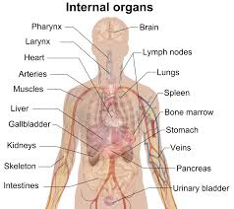

Why single cell transcriptomics?
Microarrays or bulk RNA sequencing mask the true distribution of gene expression levels across cells.
Notes:
How do we know what we are looking for if we don’t know what it looks like?

Slide 3
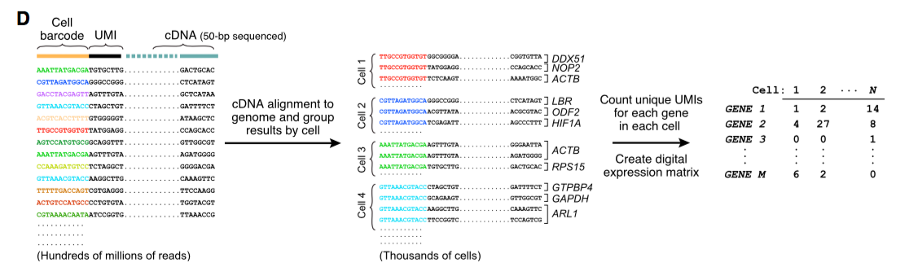
Counts Matrix
How do we get there?

Slide 4
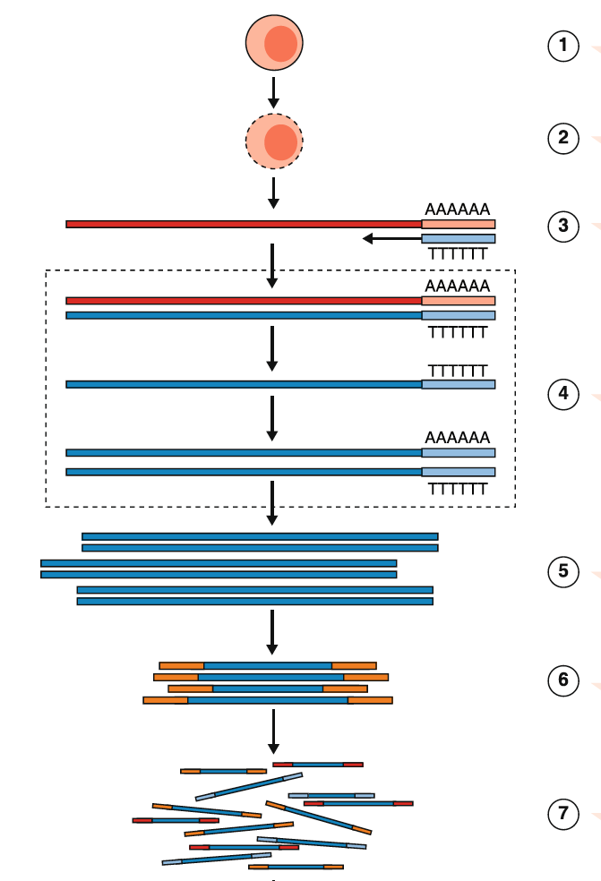
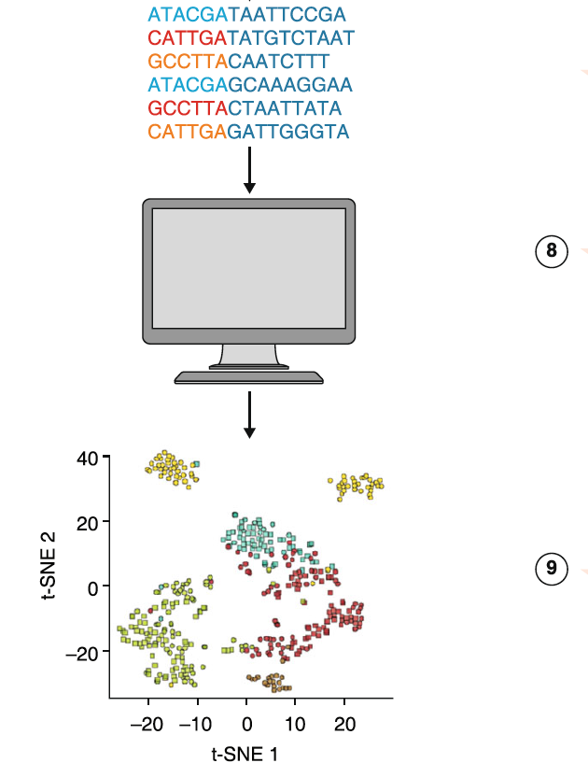
General workflow of a single cell (sc) RNA-Seq experiment
Haque et al., 2017 Genome Medicine

Slide 5
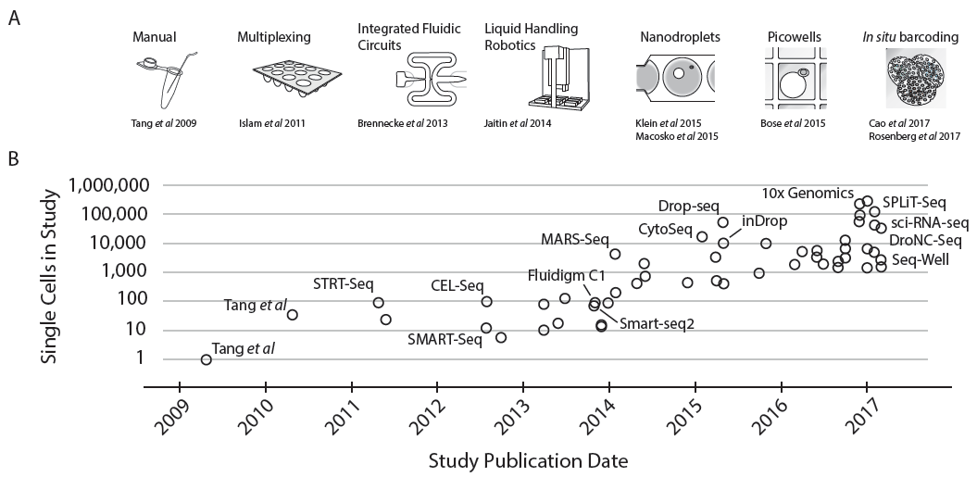
scRNA-Seq has become more popular, high(er) throughput and “more” affordable
Full-length mRNA
Few cells
3’-end mRNA
Many cells
Svensson et al., 2017 arXiv:1704.01379

Slide 6
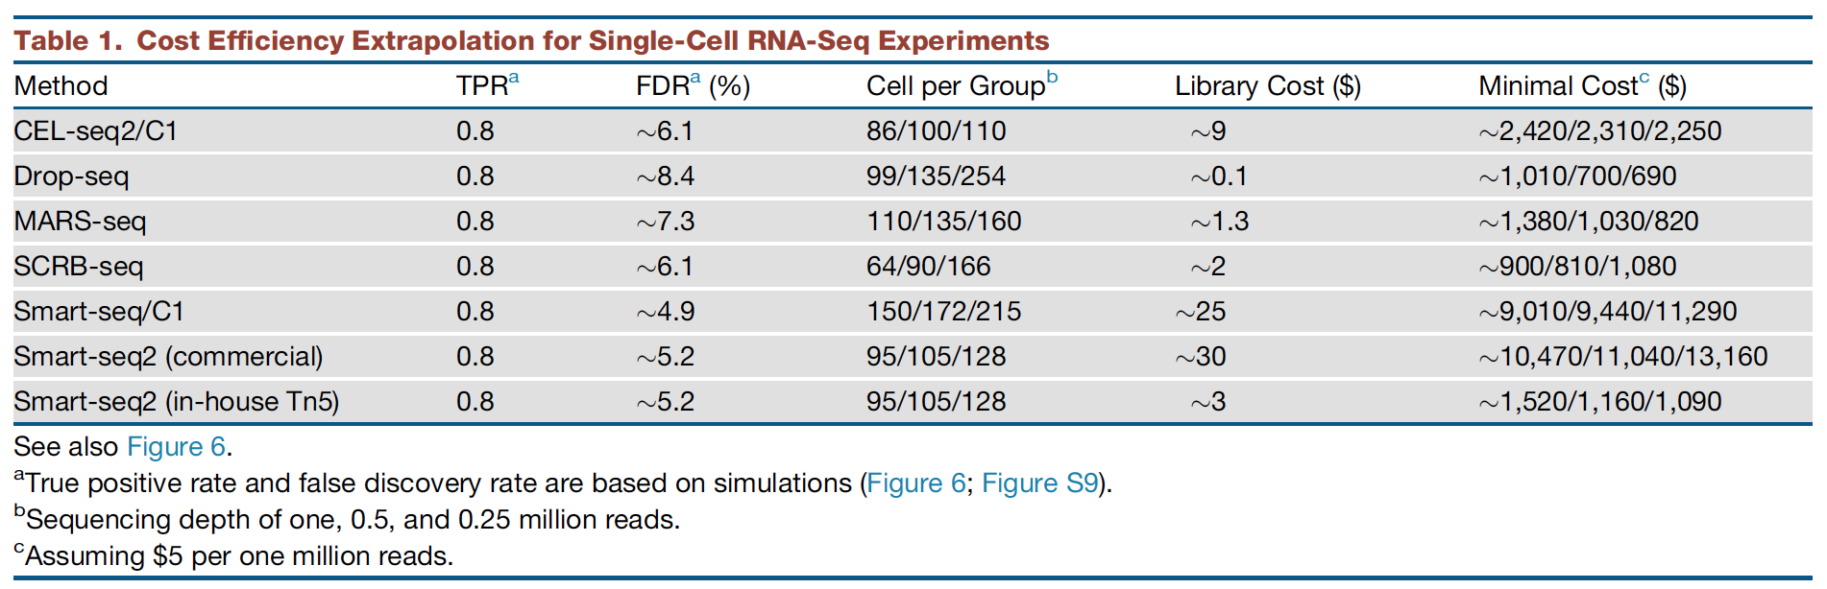
Single cell technologies (3’-end vs full-length)
Ziegenhain et al., 2017 Molecular Cell

Slide 7
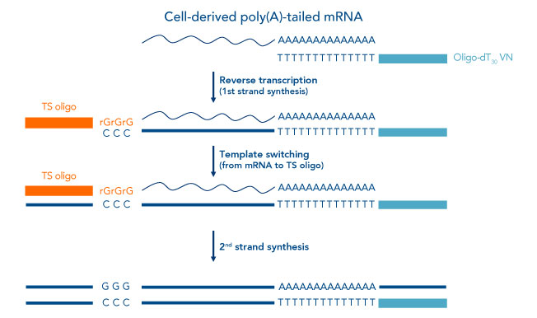
Full length mRNA Reverse Transcription (RT) is enabled by a Template Switching Oligo (TSO)
5’
3’
Notes:
Moloney murine leukaemia virus (MMLV)

Slide 8
Unique Molecular Identifiers (UMIs) allow to correct for PCR duplications but constrain us to 3’-ends
5’
3’
UMI
UMI
UMI
UMI’
UMI

Slide 9
Bead Barcodes (BBC) allow to assign multiple transcripts (UMIs) to one cell of origin
5’
3’
UMI
BBC
UMI
BBC
UMI
BBC
UMI’
BBC’
UMI
BBC

Slide 10
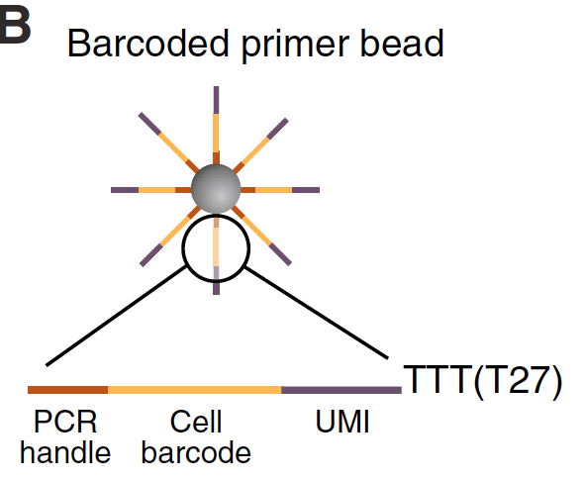
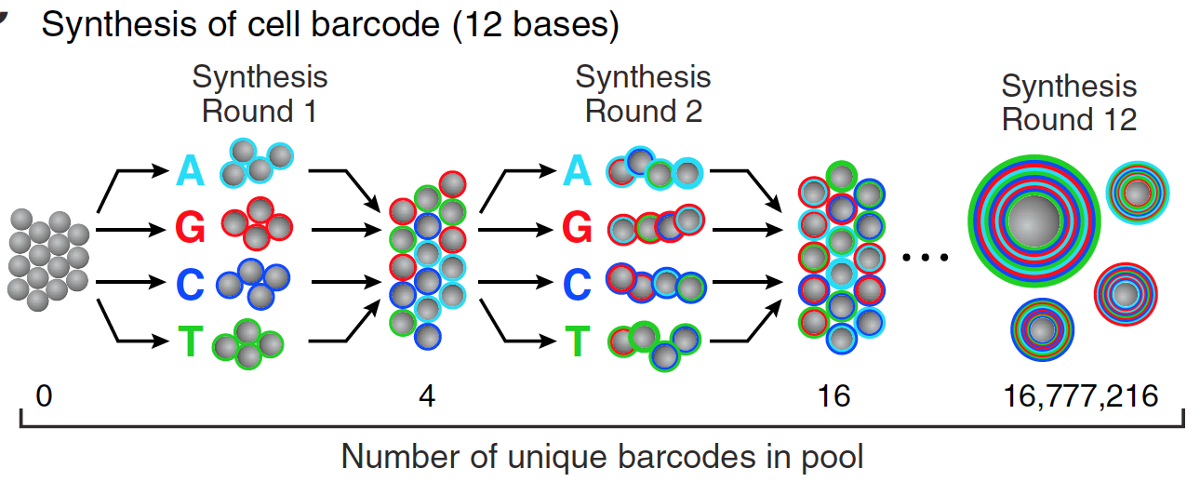
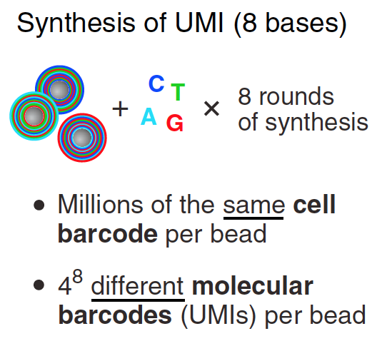
3’-end Capture Beads UMIs and Bead Barcodes
UMI
BBC
PCR
4¹² = 16,777,216 barcodes
4⁸ = 65,536 UMIs
>>10⁶ oligos/bead
Macosko et al., 2015 Cell

Slide 11
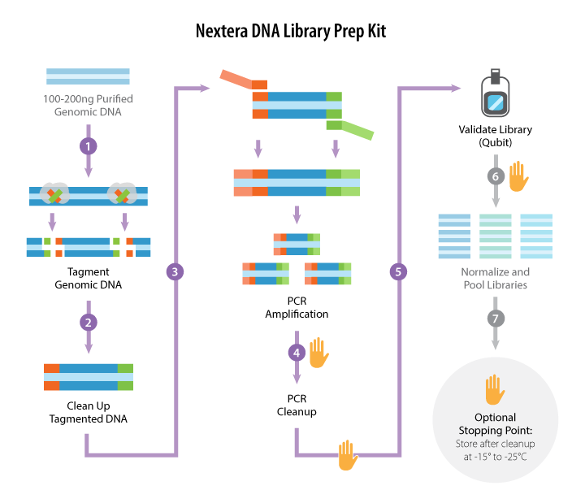
Library Prep Tagmentation
3’-end vs. full-length implications
https://www.abmgood.com/marketing/knowledge_base/next_generation_sequencing_experimental_design.php

Slide 12
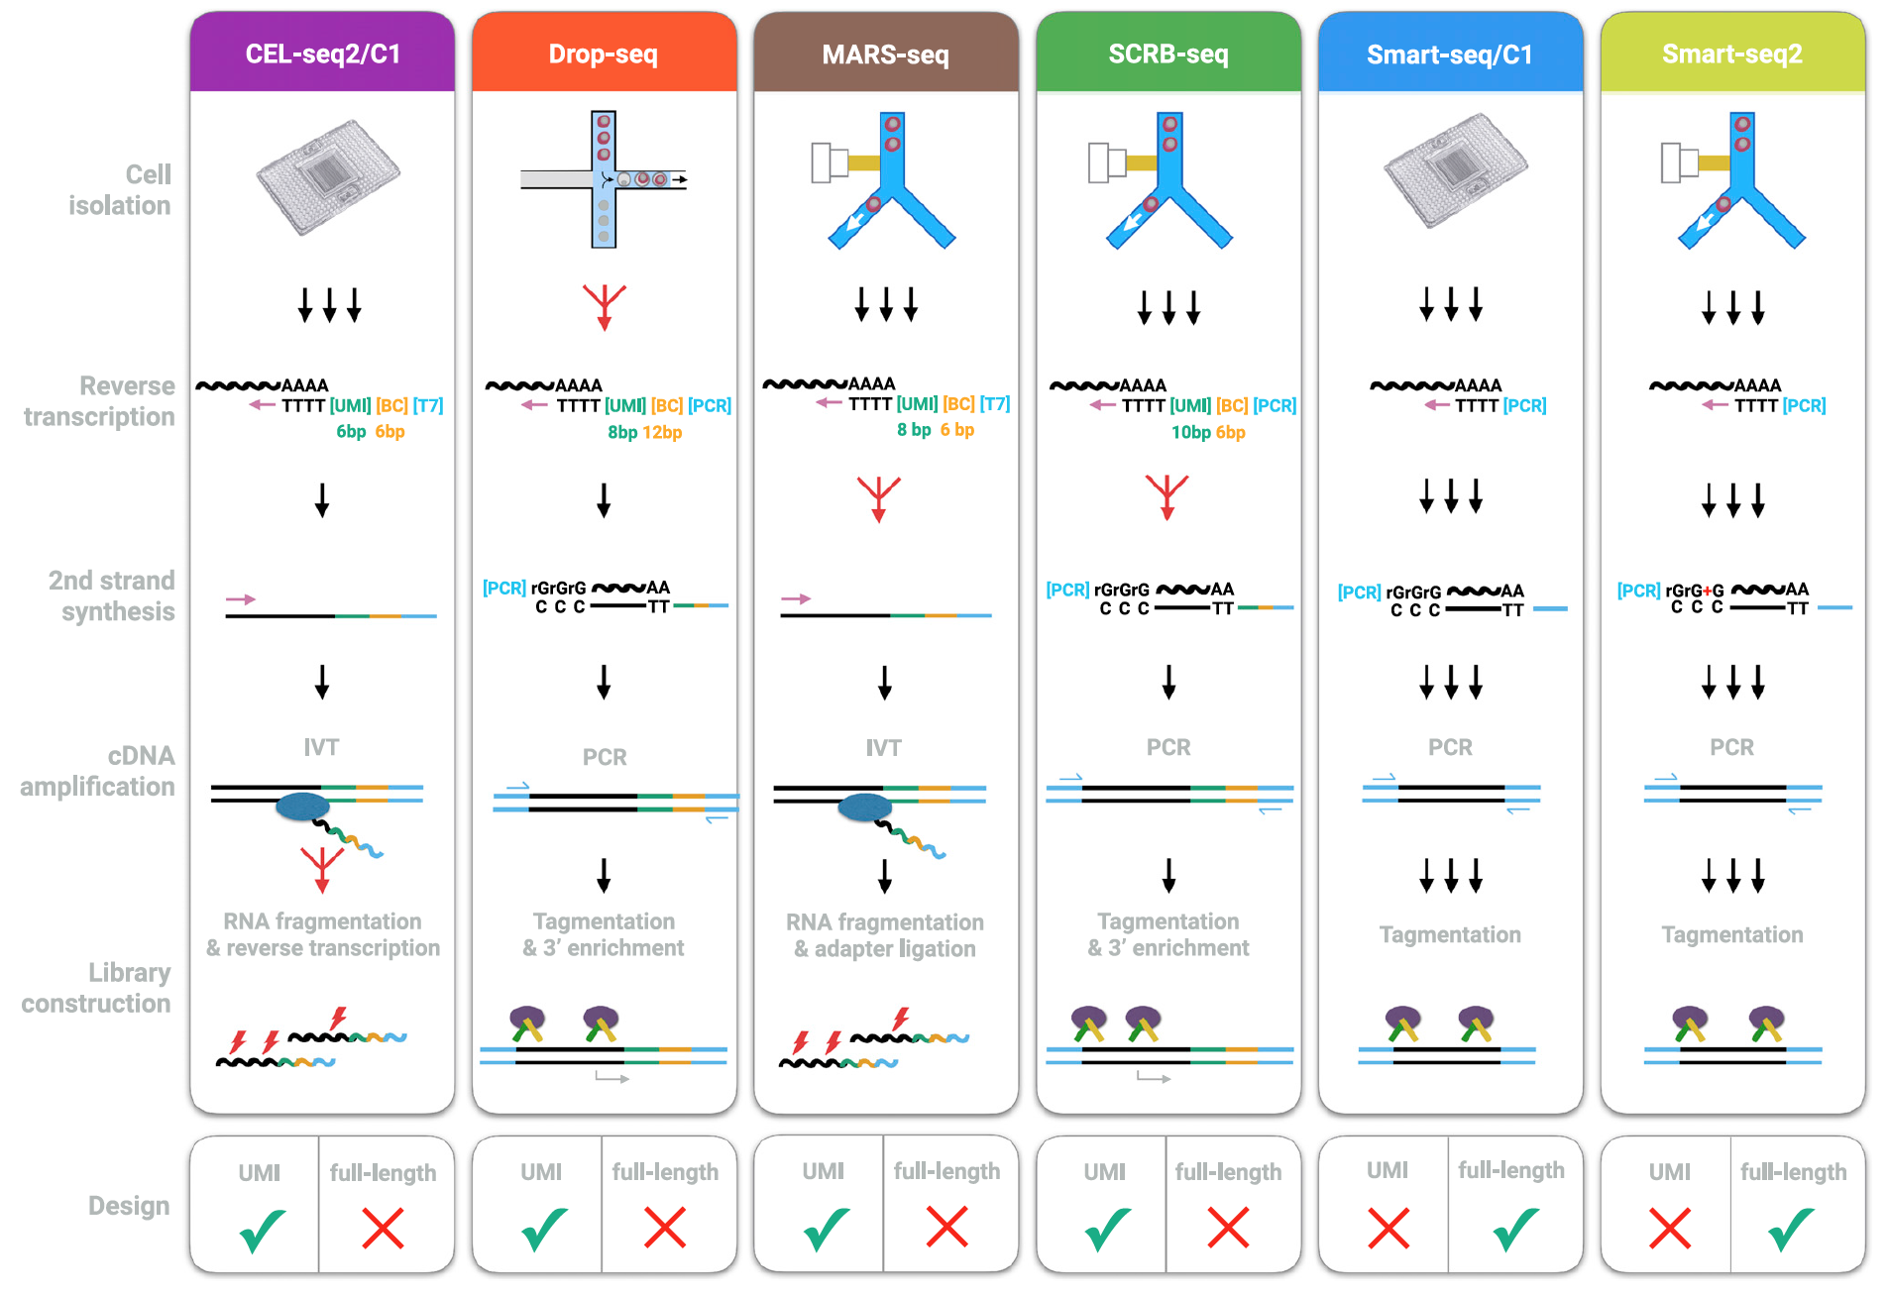
Single cell technologies (3’-end vs full-length)
Ziegenhain et al., 2017 Molecular Cell

Slide 13
Single cell technologies (3’-end vs full-length)
Ziegenhain et al., 2017 Molecular Cell

Slide 14
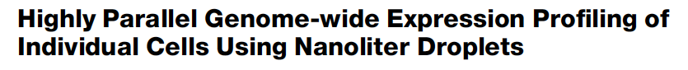
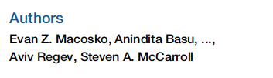
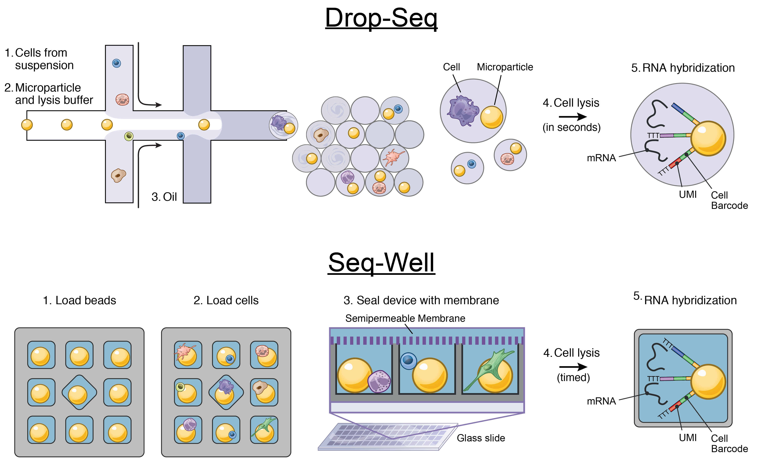
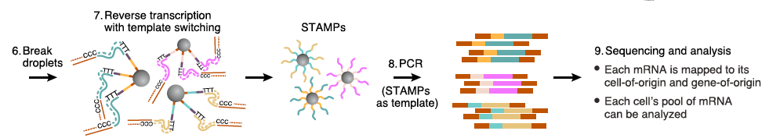
Drop-Seq
Macosko et al., 2015 Cell

Slide 15
Drop-Seq implementation
Capture rate < 10%

Slide 16
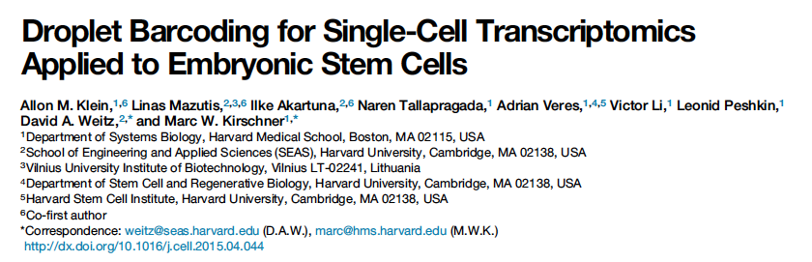

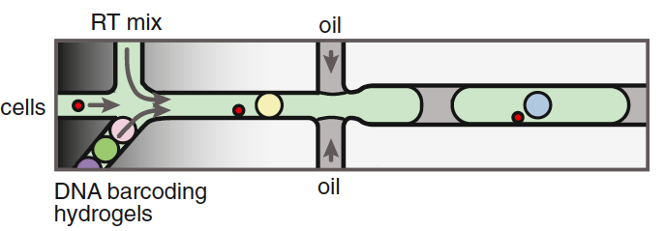
inDrop
Capture rate > 50%
inDrop + DropSeq → 10X

Slide 17
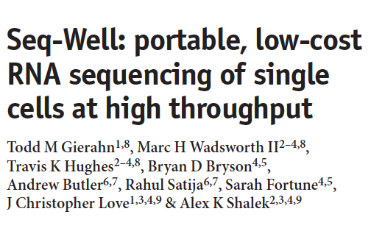

Seq-Well abrogates the need for droplet-based microfluidic devices
Capture rate > 50%

Slide 18
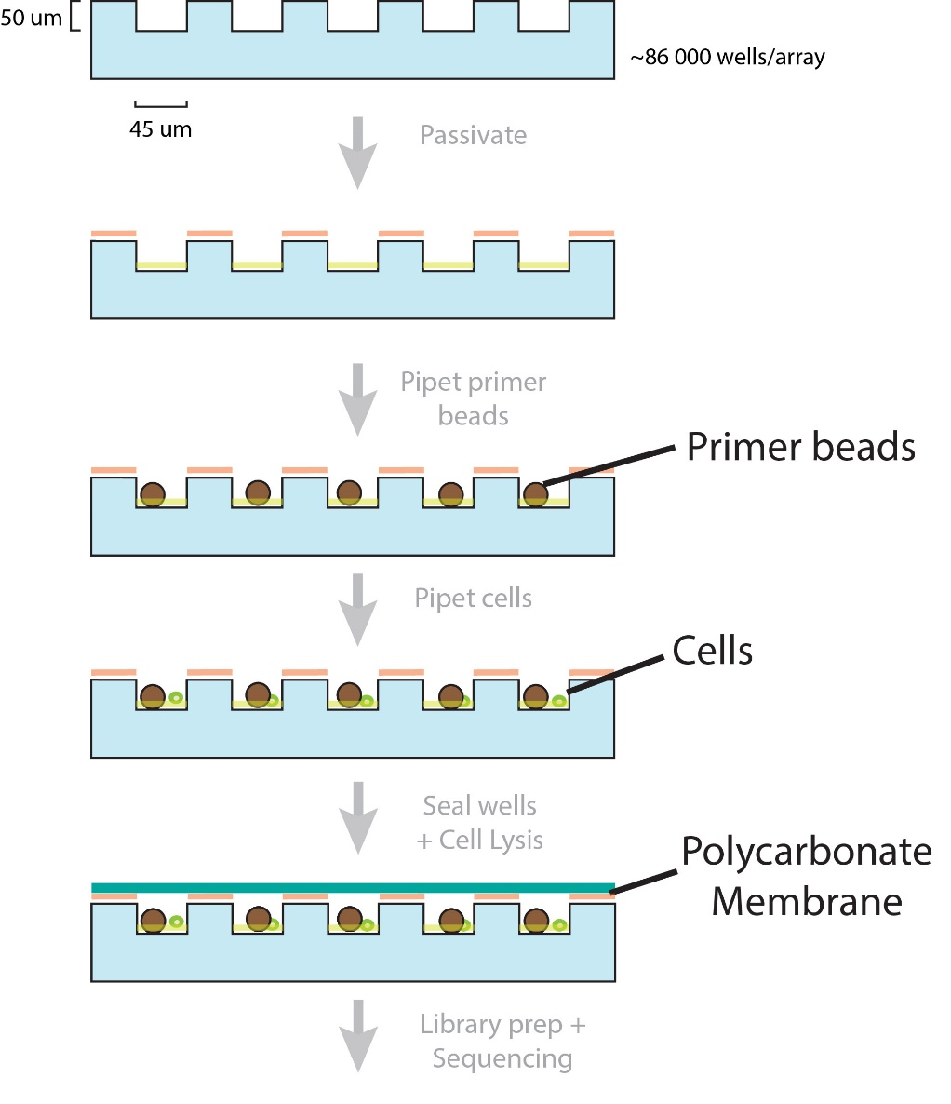
Seq-Well workflow in Images
Pre-wash
100 um
Post-wash + shake
100 um

Slide 19
Seq-Well workflow in Images
Pre-cell loading
100 um
Post-cell loading + shake
Cell
Bead
100 um
Capture rate > 50%

Slide 20


Doublet rate: Barnyard Experiment

Slide 21
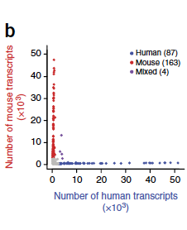
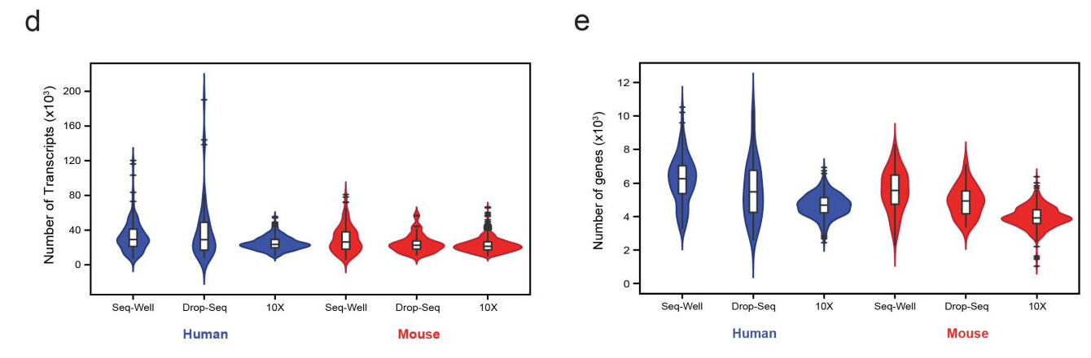
Doublet rate: Inter-platform comparison

Slide 22
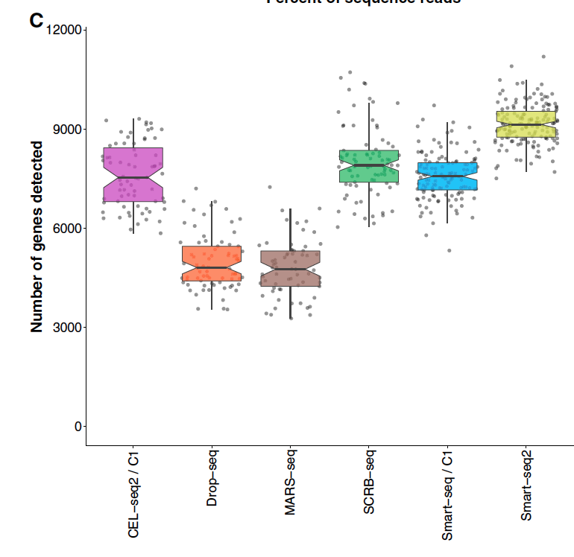
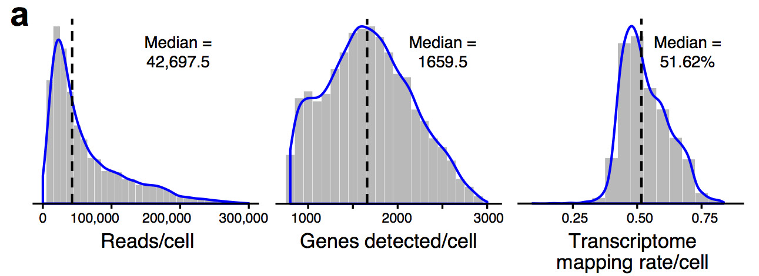
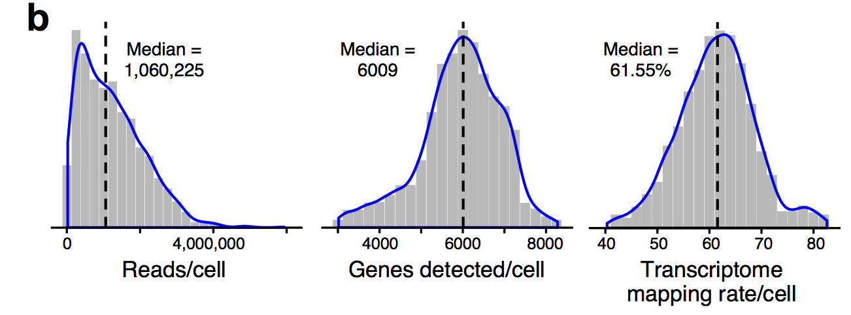
3’-end vs full-length Inter-platform comparison
10X
Smart-Seq2
Ziegenhain et al., 2017 Molecular Cell
Haber et al., 2017 Nature

Slide 23
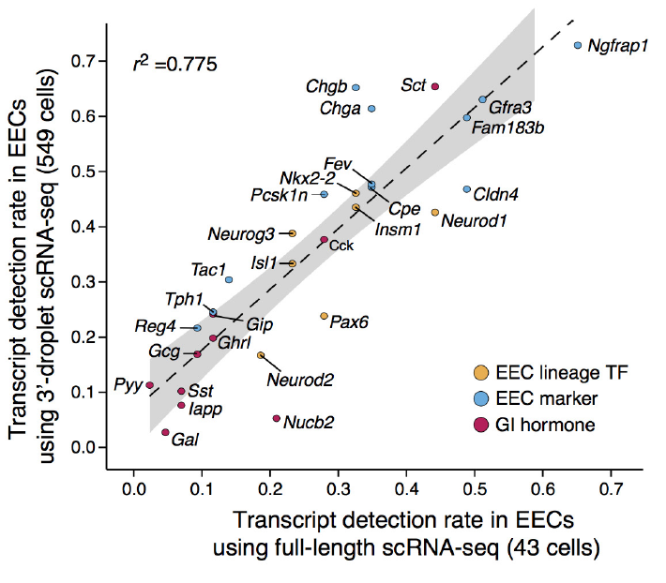
3’-end vs full-length Inter-platform comparison
Haber et al., 2017 Nature

Slide 24
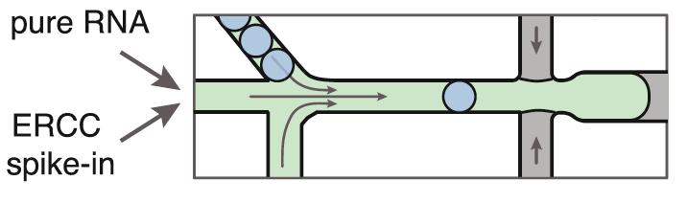
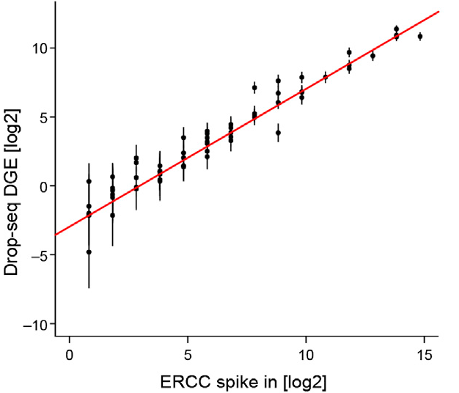
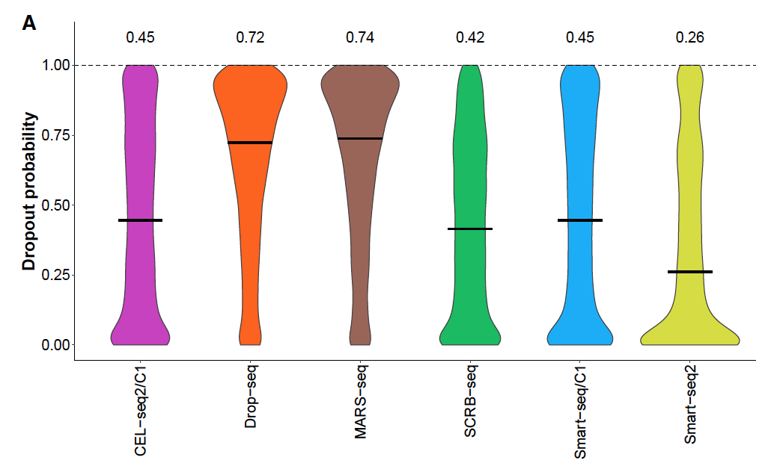
Dropout rates ERCC spike-ins
ERCC
External RNA Controls Consortium
Inter-platform comparison
Dropout rate
Klein et al., 2015 Cell
Ziegenhain et al., 2017 Molecular Cell
Macosko et al., 2015 Cell

Slide 25
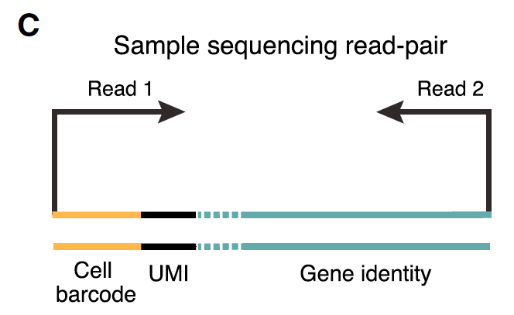
3’-end based technologies Post-sequencing

Slide 26
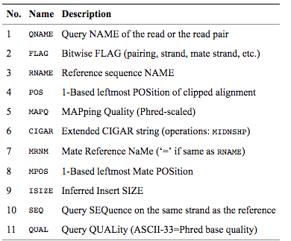
SAM/BAM File
BAM files are binary, you must use samtools to view them
Bioinformatics. 2009 Aug 15;25(16):2078-9. Epub 2009 Jun 8. The Sequence Alignment/Map format and SAMtools.

Slide 27
Analysis pipeline (dropseqtools)
Goal = read1+read2 -> Counts Matrix
Fastqs
Unmapped queryname BAM
Tag cell barcodes
Tag molecular barcodes
Trim 5’ primer sequence
Trim 3’ polyA sequence
STAR alignment
Sort STAR alignment in queryname order
Merge STAR alignment tagged SAM to recover cell/molecular barcodes
Add gene/exon and other annotation tags

Slide 28
From beads … through mRNA capture ... sequencing ... to counts matrix
Split and Pool x 12 = Bead Barcode
…PCRHANDLEJJJJJJJJJJJJJJJJ
Equimolar Mix of four bases x 8 = UMI
…PCRHANDLEJJJJJJJJJJJJJJJJNNNNNNNN
T x 30 = polyT
…PCRHANDLEJJJJJJJJJJJJJJJJNNNNNNNNTTTT...TTTTT
mRNA hybridization + RT + …
…PCRHANDLEJJJJJJJJJJJJJJJJNNNNNNNNTTTT...TTTTT...mRNAmRNAmRNAmRNAmRNA
Notes:
Methacrylic polymer

Slide 29
Analysis pipeline (dropseqtools)
Goal = read1+read2 -> Counts Matrix
Fastqs
Unmapped queryname BAM
Tag cell barcodes
Tag molecular barcodes
Trim 5’ primer sequence
Trim 3’ polyA sequence
STAR alignment
Sort STAR alignment in queryname order
Merge STAR alignment tagged SAM to recover cell/molecular barcodes
Add gene/exon and other annotation tags
Read1
...JJJJJJJJJJJJJJJJNNNNNNNNTTTTTTT
Read 2
...mRNAmRNAmRNAmRNAmRNA

Slide 30
3’-end based technologies Post-sequencing

Slide 31
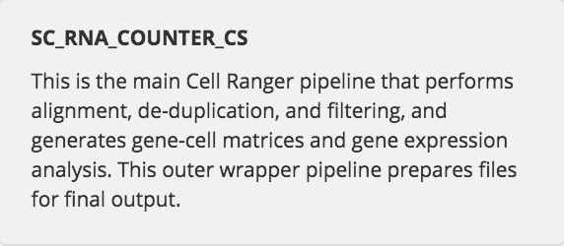
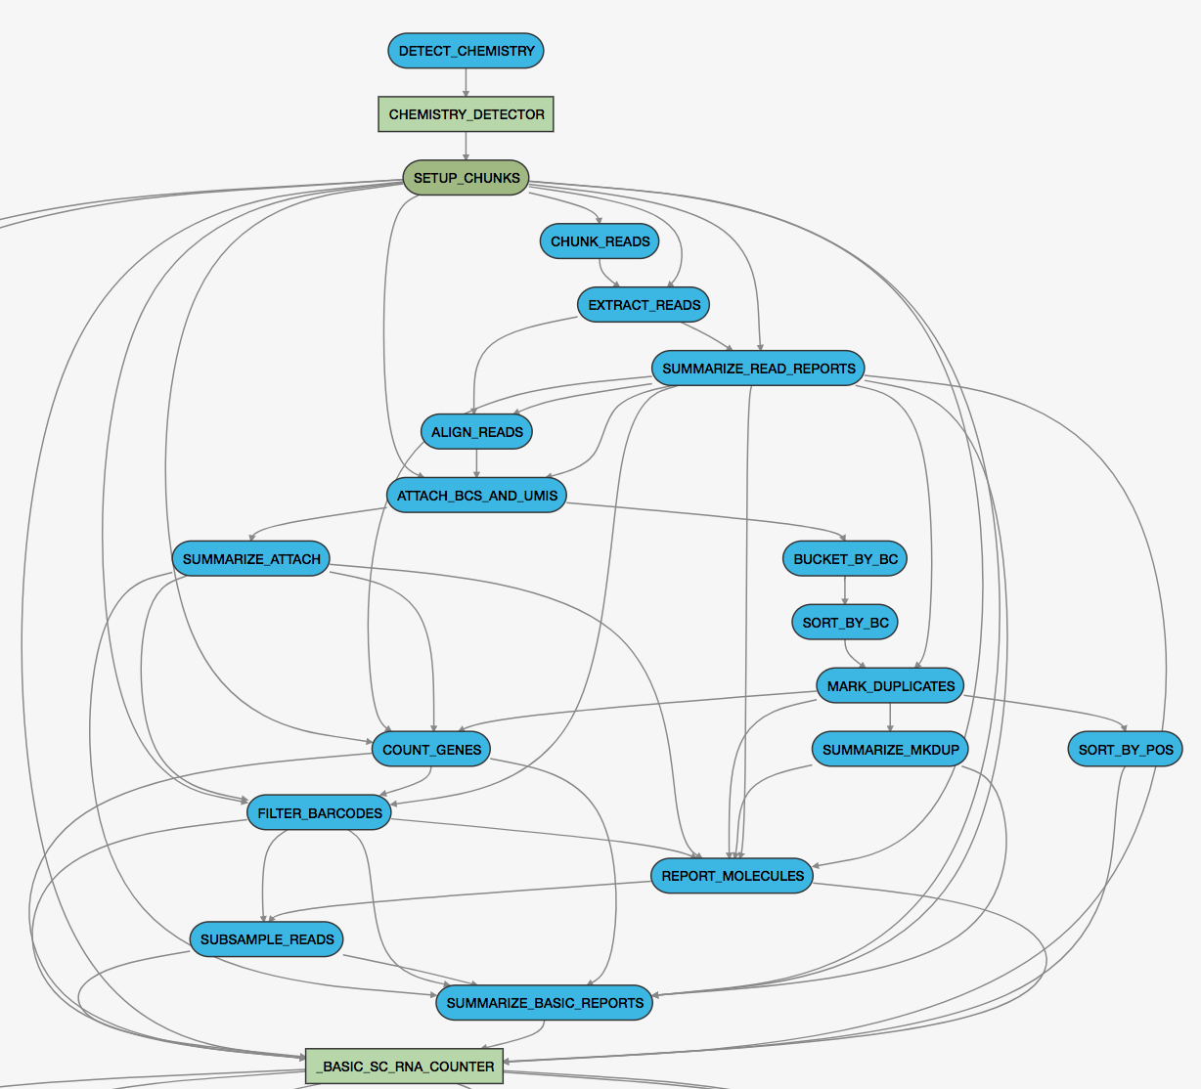
10X - cell ranger pipeline

Slide 33
Template switching PCR is an alternative strategy that ensures the full transcription of the RNA. This method is based on the intrinsic ability of the transcriptases of the Moloney murine leukaemia virus (MMLV) to add a small number of nucleotides (mostly cytosines) when the RT reaches the end of the mRNA (Zhu et al., 2001).

Slide 34
Library prep for sequencing
5’
Barcoded bead + mRNA
3’
TTT
mRNA capture in microwells
5’ cap
3’
bulk
TTT
CCC
RT
TTT
PCR-amplify template
Transposome, adaptor oligos
Tagment library,
amplify
TTT
~350 – 850 bp
20 bp 5’ read (barcode, UMI), 50 bp 5’ read (mRNA sequence tag)
modified from Macosko, et al. Cell 161:1202

